Slide 1
Week 9 Presentation
Wednesday, October 23, 2019
ATLAS Data analyst team:
Smruthi Iyengar
Kagen Jet Quiballo
Hanqing Wang
Yuxin Wang
Notes:
Welcome to our week 9 presentation. We are ATLAS Data Mining team. [self intro based on the list, name, major, title] The objective of this project is to study what impacts students’ matriculation from a financial perspectives.

Slide 2
Introduction
A quick summary of last week’s presentation
Different types of non-continuing students
Different cases, and different students
Matriculation by college and residency
Hold data and matriculation
This week: investigating variables for predictive analysis
Financial aid and payment methods
Notes:
For this week, first we are going to talk about the overview dropout from fall 17 all the way to Sp19 semester by semester. Then, we are going to focus on the dropout rate based on specific categories, like dropout rate by different groups, by colleges, by hold and by residency. Thus, I will leave the stage to Kagen.

Slide 3
METHODS
UNDERGRADS
accurate & representative
accuracy
matched demographics within 0.5%
example
blanks in S18 →
look for refund during
active term (F17)
REFUND
for corresponding term
CREDIT HOURS
no blanks/0s → blanks/0s
blank (did not register)
0 (registered and dropped)
Notes:
First talk about the methods → start with yellow, then blue, then green

Slide 4
UG DISCONTINUE: AT LEAST ONE SEMESTER
LAST WEEK
F17 | S18 | F18 | S19 | COUNT | REFUND TUITION
 | did not continue |  |  | 2,491 | 1,231
 |  | did not continue |  | 3,904 | 2,545
 |  |  | did not continue | 1,965 | 976
*overlap of 108 students in rows 1 & 3
Notes:
Start with total. Talk a little bit about each semester jump
Then the trend of spring to fall dropout

Slide 5
UG DISCONTINUE: “COMPLETE DROPOUT”
F17 | S18 | F18 | S19 | COUNT
 |  |  |  | 2,069
 |  |  |  | 3,643
 |  |  |  | 1,857
 |  |  |  | 10,724
Notes:
Start with total. Talk a little bit about each semester jump
Then the trend of spring to fall dropout

Slide 6
UG DISCONTINUE: SKIPPING SEMESTERS
F17 | S18 | F18 | S19 | COUNT
 | skip 1 |  |  | 375
 |  | skip 1 |  | 261
 | skip 2 |  |  | 47
Notes:
Start with total. Talk a little bit about each semester jump
Then the trend of spring to fall dropout

Slide 7
UG DISCONTINUE: RECODING FOR MODELING
Including those who graduated in that time
F17 |  | F18 |  | CODE
enrolled |  | continues |  | 1
enrolled |  | discontinues |  | 0
Notes:
Start with total. Talk a little bit about each semester jump
Then the trend of spring to fall dropout

Slide 8
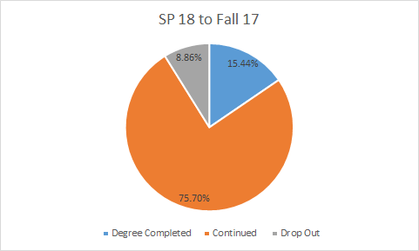
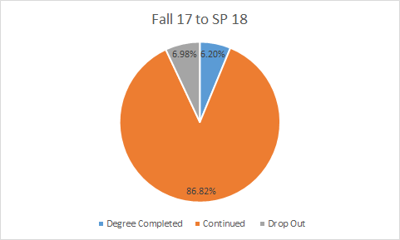
Undergraduate’s Drop out
Fall 2017: 18,957
Spring 2018: 17,763
Notes:
After receving new data, we were able to exclude all the students who drop out before completing the fall 2017. On the left upper coner. The number represent

Slide 9
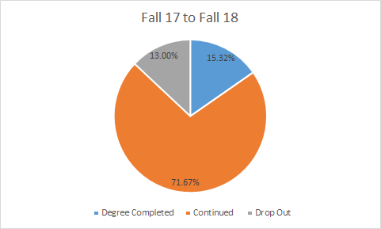
Undergraduate’s Drop out
 | Fall 17 to SP 18 | SP 18 to Fall 17 | Fall 17 to Fall 18
Drop Out Rate | 7.45% | 10.47% | 15.35%

Slide 10
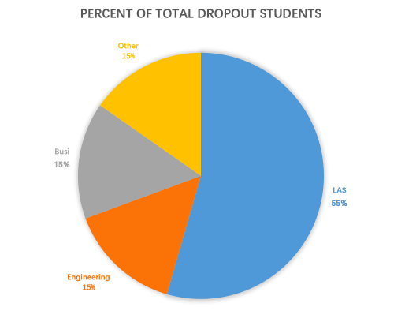
By college
Fall 2017 to Fall 2018
Liberal Art & Science: 55%
Business College: 15%
Engineering: 15%
Notes:
For all students who dropout from fall2017 to fall2018, 55% are LAS students, 15% are from business college, 15% are from engineering college, and 15% are from other colleges.

Slide 11
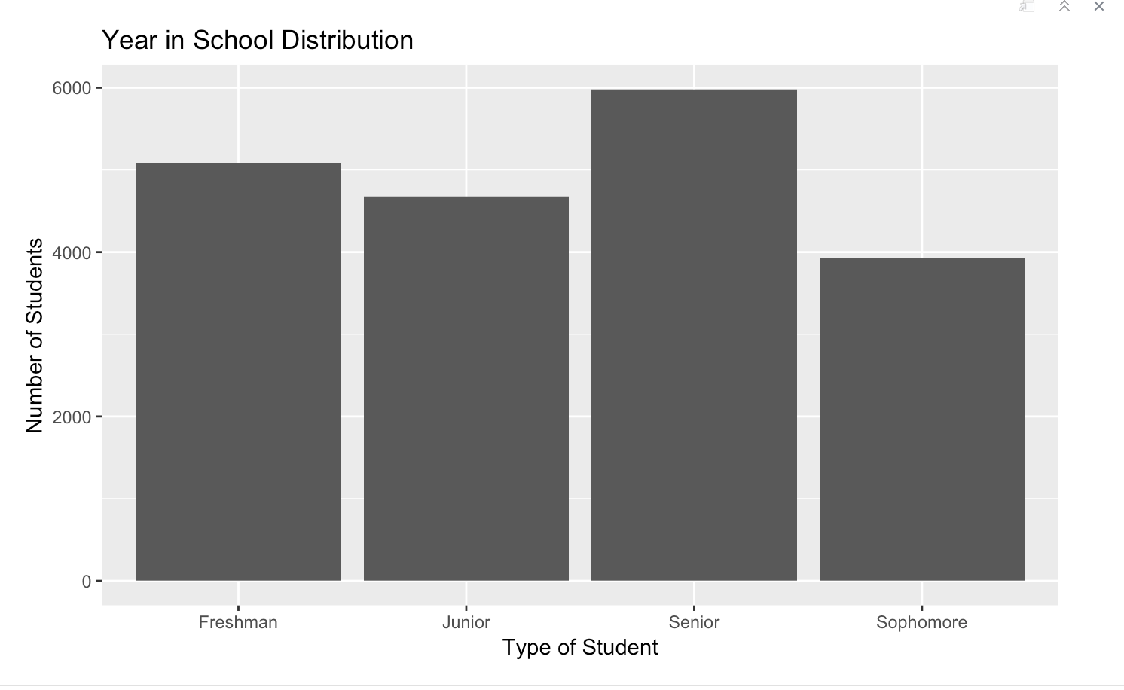
Updated Year in School Data
Using Census data instead of inaccurate banner data
All Fall 2017

Slide 12
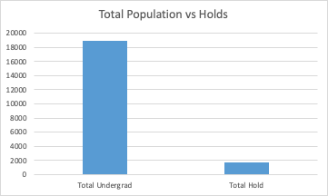
Percent of Undergrads that had a Hold (Fall 2017)
1655 undergraduates had a hold in Fall 2017
9 percent of total undergrad

Slide 13
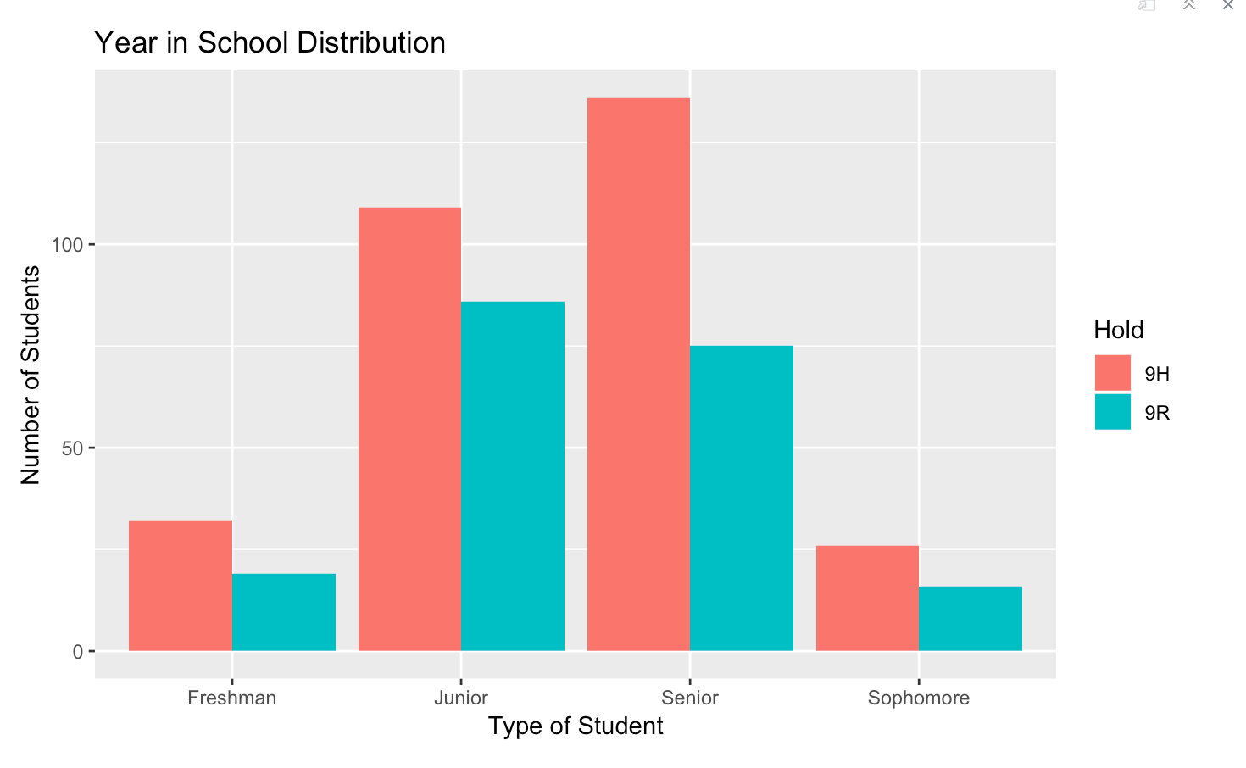
Holds that lead to Drop Outs by Year in school

Slide 14
Summary of Last Week’s Key Findings
Most students who don’t continue do so from S18 to F18.
Enrolled as First year Freshmen has highest dropout rate.
Students who dropout from F17 to F18 are generally from LAS
Holds that lead to dropout- Most that dropout are Upperclassmen

Slide 15
This Week:
Cleaning and Investigating Variables for Modeling and Analysis

Slide 16
Financial Aid (from ‘updated 9/30’)
Waivers
Scholarship
Loan
Work
Other
DISCRETIONARY FEE WAIVER
DISCRETIONARY TUITION WAIVER
STATUTORY FEE WAIVER
STATUTORY TUITION WAIVER
TUITION WAIVER
ESTIMATED SCHOLARSHIP
GENERAL SCHOLARSHIP
SCHOLARSHIP
GRANT
PRIZE AWARD
UIC GRANT/AWARD
LOAN
WORK
BENEFIT
EXEMPTION
17,576
79,962
93,761
7,621
114
Notes:
Benefits and exemptions - institutional
All waivers - institutional
Scholarships - institutional (unless it says ‘external’)
Grants: Pell grant - federal | Map grant - state | Other grants - (external)
Loan - most are federal (external)
prize/award - institutional
UIC Grant - institutional
Work - federal (external)

Slide 17
Consider the Questions: Predictive Analysis
2) Are students from a specific college or degree program more or less likely to receive financial aid?
[financial aid: binary] ~ [college]
5) Does funding method (methods of payment/financial aid) impact enrollment in a subsequent term (matriculation)
[matriculation: binary] ~ [financial aid: ratio] + [payment: ratio]

Slide 18
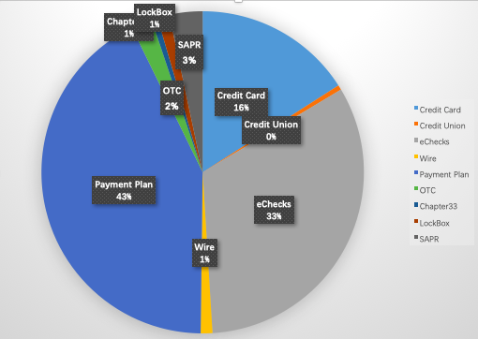
Payment Method (from new data set)
Credit Card + OnPlan
Credit Union
eChecks + OnPlan
Wire + Flywire
Payment Plan
OTC
Chapter 33
Lock Box
SAPR
27522
833
56329
2030
73527
3609
1059
2078
5747
Payroll Deduction, Refund Payment, Sponsor Billing, and wire-off:
Each was chosen by less than 250 students

Slide 19
This Week:
-Clean variables for Financial Hold, Financial Aid, and Payment Method
-Prepare for modeling and predictive analysis

Slide 20
Thank you for listening!
Questions?

